Slide 1
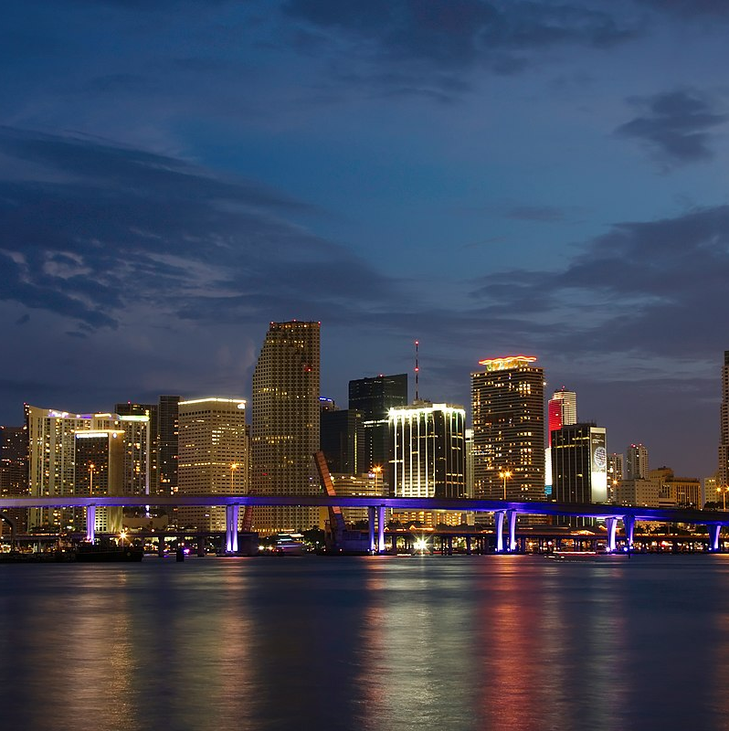

Florida USPS Contacts
Updated 6/26/2026

Slide 2

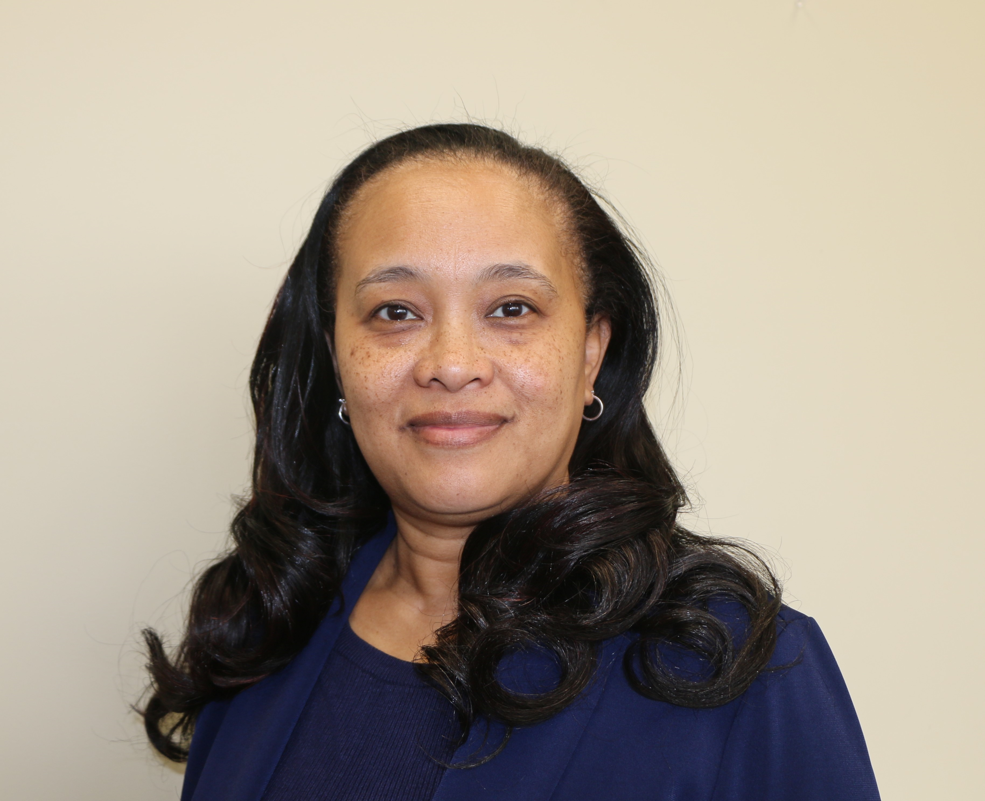

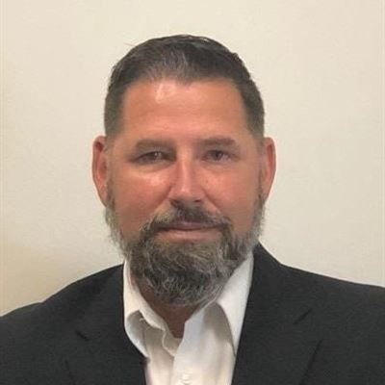

Contact your Customer Relations Managers
This election season, the Postal Service has designated a single point of contact for Election Mail planning, questions, and issue resolution. Your point of contact is supported by a nation-wide team of dedicated postal employees who are deeply knowledgeable about and fully committed to the timely delivery of Election Mail.
Denese Baines, FL 1 Manager Customer Relations
Phone: (904) 359-2711
Email: Denese.M.Baines@usps.gov
Robert Gaskin, FL 2 Manager Customer Relations
Phone: (813) 354-6064
Email: Robert.S.Gaskin@usps.gov
Joycelynn King, FL 3 Manager Customer Relations
Phone: (954) 527-3261
Email: Joycelynn.King@usps.gov

Slide 3

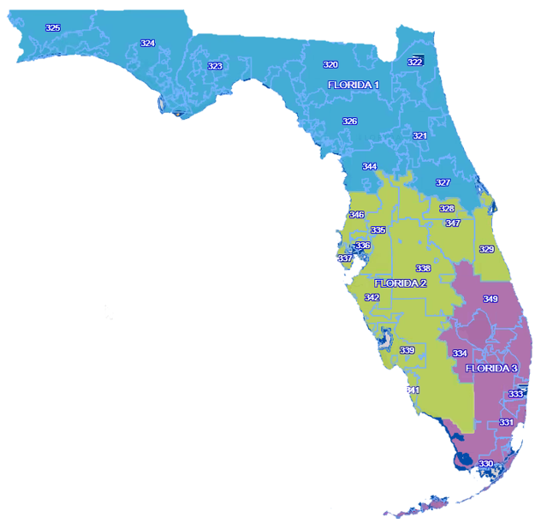
Tool Automation
2026 | Florida USPS Contacts
FL-1
(Jacksonville)
320-327, 344
Customer Relations Manager
Denese Baines, (904) 359-2711; Denese.M.Baines@usps.gov
District Manager
FL-2
(Tampa)
328-329, 335-339, 341-342, 346-347
Customer Relations Manager
Robert Gaskin, (813) 354-6064; Robert.S.Gaskin@usps.gov
District Manager,
FL-3
(Ft. Lauderdale / Miami)
330-334,
349
Customer Relations Manager
Joycelynn King, (954) 527-3261; Joycelynn.King@usps.gov
Shelley Sally, (407) 812-1190; shelley.m.sally@usps.gov / Seneca Lucas, (904) 645-3220 Seneca.Lucas@usps.gov
Shirley Hoffman, Shirley.A.Hoffman@usps.gov / Seneca Lucas, (904) 645-3220; Seneca.Lucas@usps.gov
Mary Ann Palacios, (954) 527-3271; Mary.A.Palacios@usps.gov / Seneca Lucas, (904) 645-3220 Seneca.Lucas@usps.gov
Corey Richards, Corey.D.Richards@usps.gov
Richard Fermo, Richard.Fermo@usps.gov
Business Mail Entry Contact
Lisa Garrett, Lisa.A.Garrett@usps.gov
Business Mail Entry Contact
Business Mail Entry Contact
District Manager/A
ALA, BAK, BAY, BRA, BRE, CAL, CIT, CLA, CLM, DIX, DUV, ESC, FLA, FRA, GAD, GIL, GUL, HAM, HOL, JAC, JEF, LAF, LAKE, LEO, LEV, LIB, MAD, MRN, NAS, OKA, PUT, STJ, SAN, SEM, SUW, TAY, UNI, VOL, WAK, WAL, WAS
CHA, COL, DES, HAR, HEN, HER, HIG, HIL, IND, LEE, MAN, ORA, OSC, PAS, PIN, POL, SAR, SUM
BRO, GLA, MAR, MIA, MON, OK, PAL, STL

Slide 4
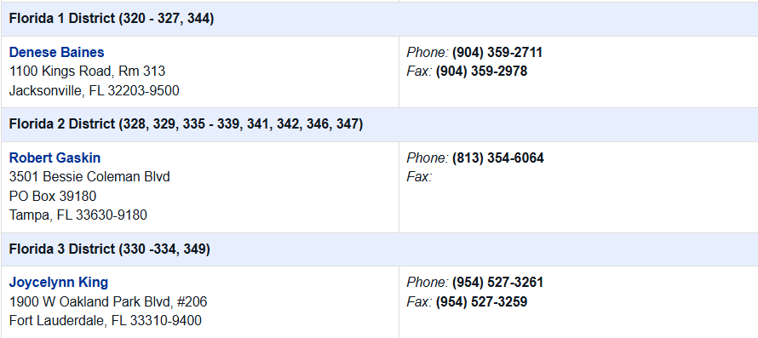
Tool Automation
2026 | Florida USPS Contacts

